Slide 1
Functional and pathological amyloid proteins
Sensors CDT | Department of Chemical Engineering and Biotechnology

Slide 2
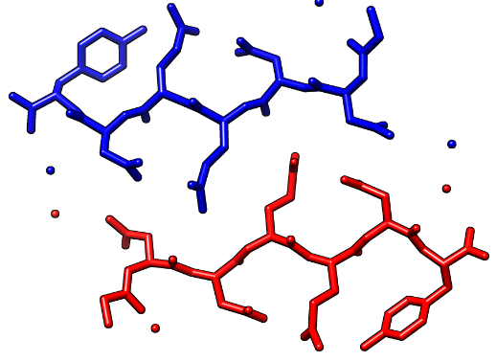
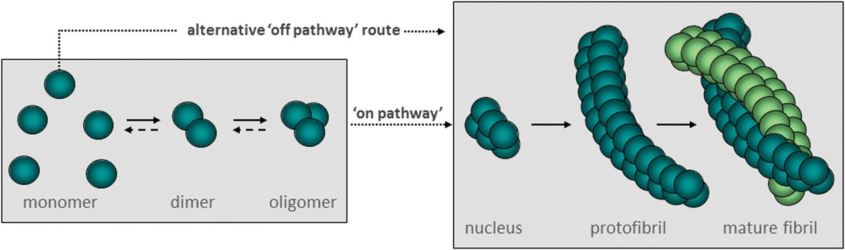
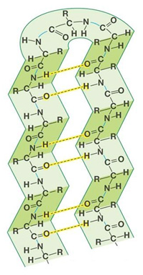
The amyloid state and its formation
Colletier et al. 2011
D. Allsop et al. 2014

Slide 3
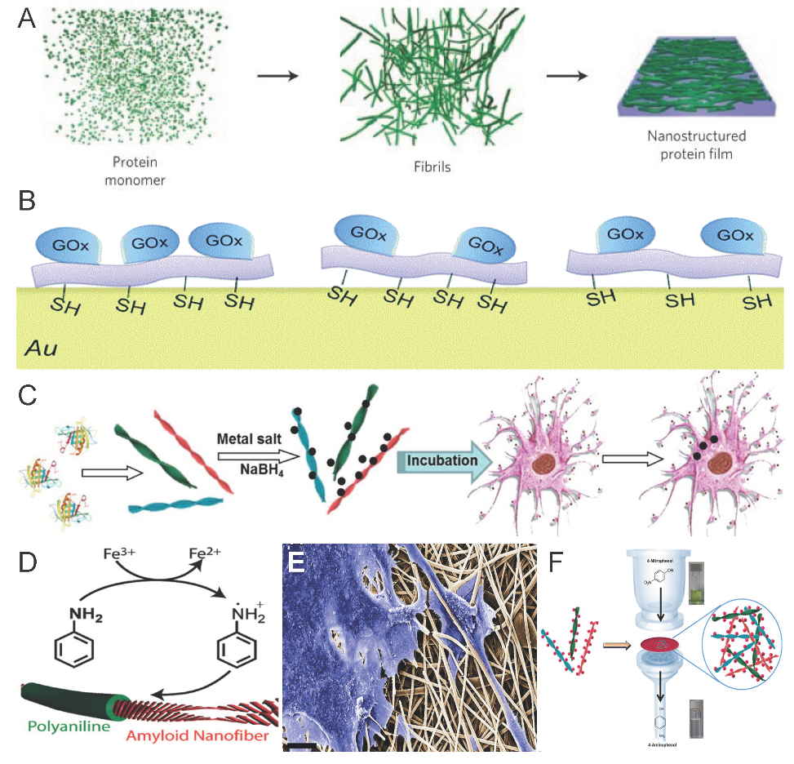
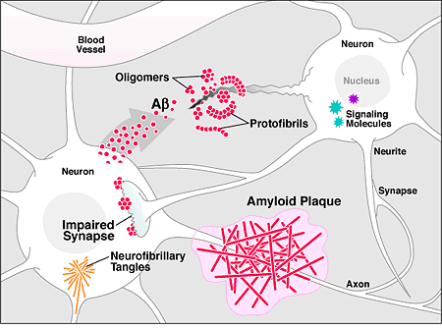
Diversity of amyloid proteins
Pathological Amyloids
Functional Amyloids
Knowles et al. 2010
Sasso et al. 2014
Meier et al. 2015
Bolisetty et al. 2014&2015

Slide 4
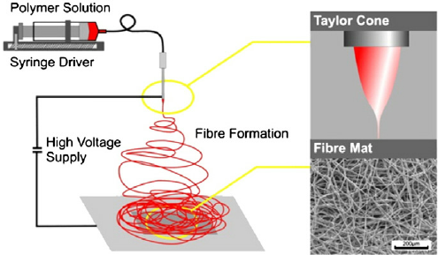
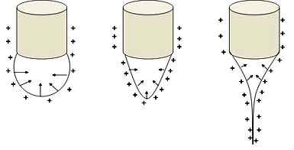
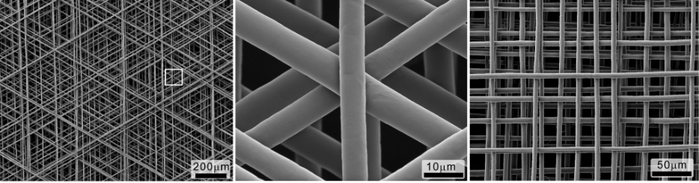
Some principles of electrospinning
Nieuwland et al. 2013

Slide 5
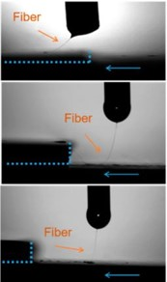
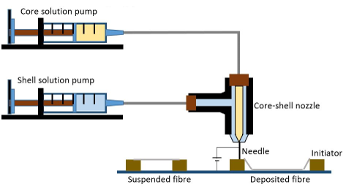
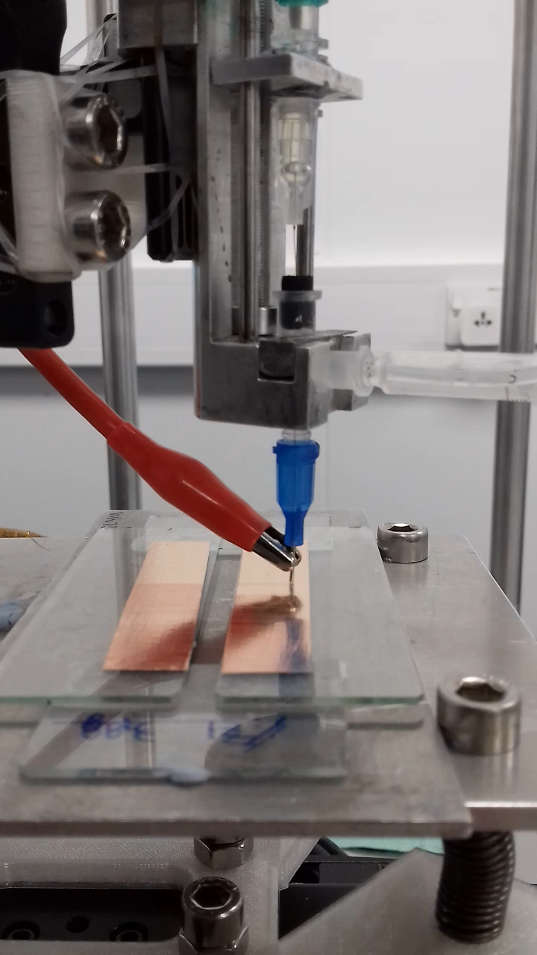
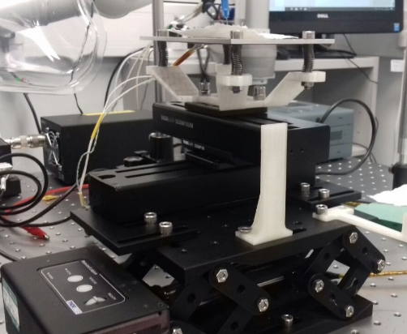
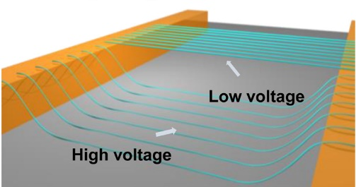
A near-field electrospinning setup

Slide 6
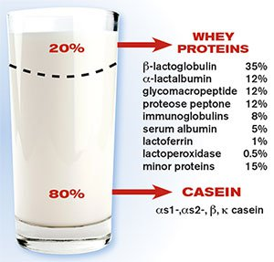
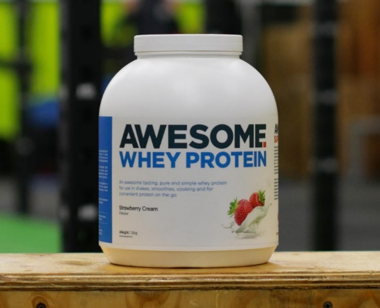
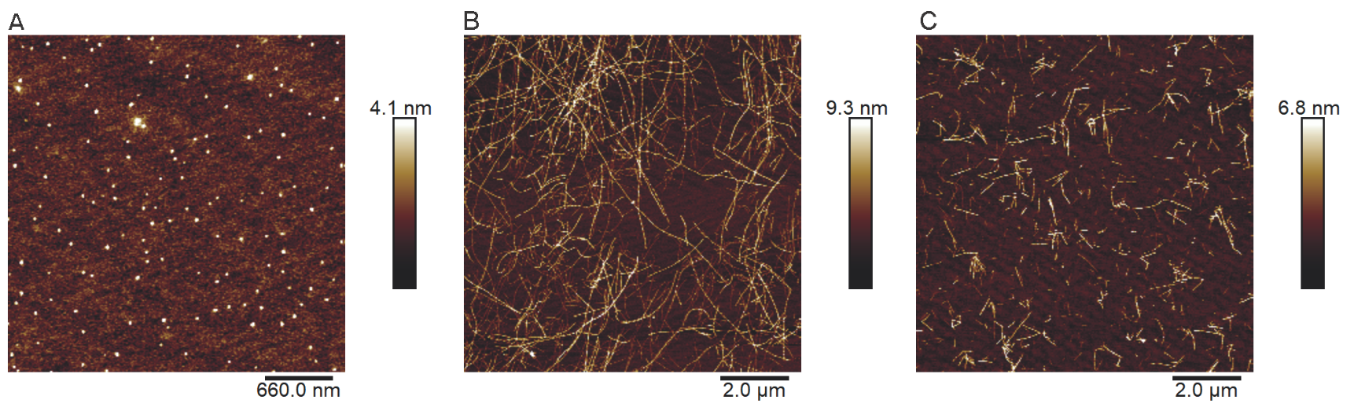
β-lactoglobulin as amyloid source

Slide 7
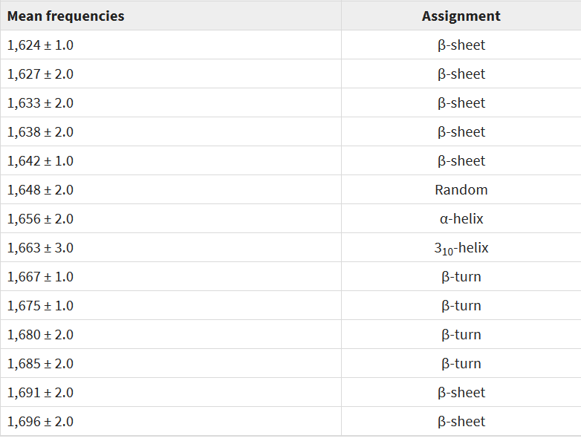
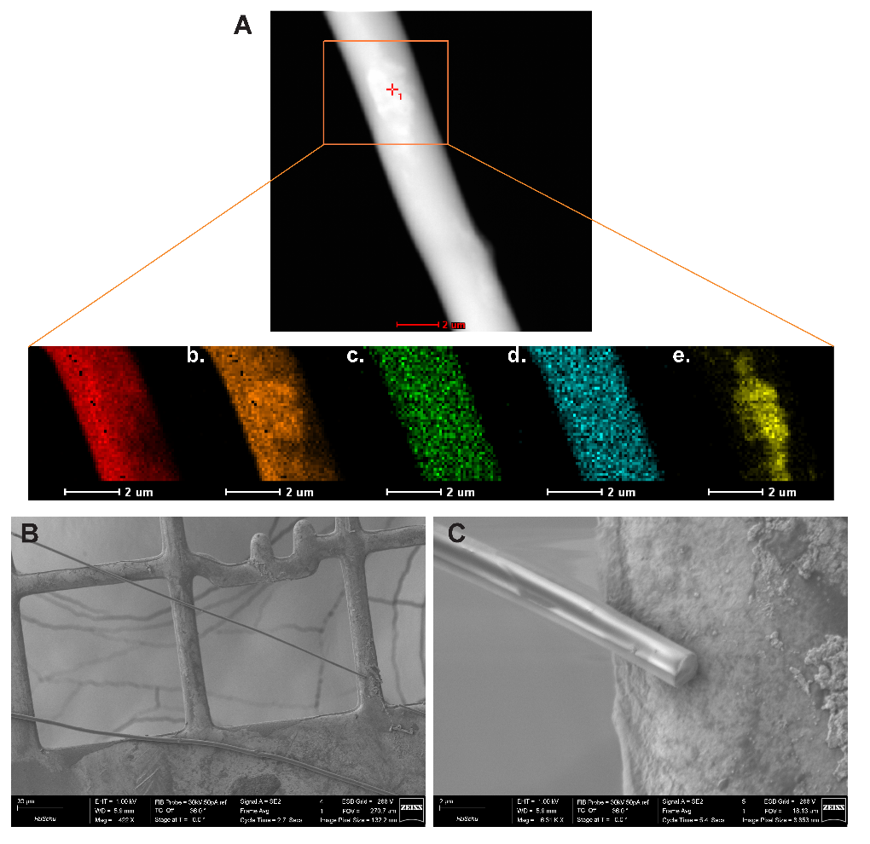
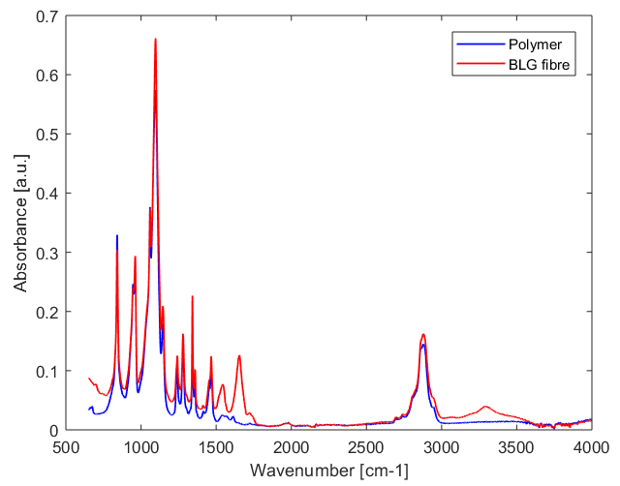
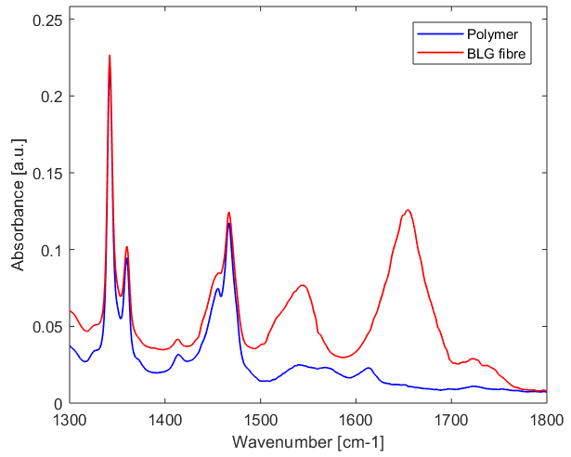
Fibre characterisation II
Yang et al. 2015
~1655 cm⁻¹

Slide 8
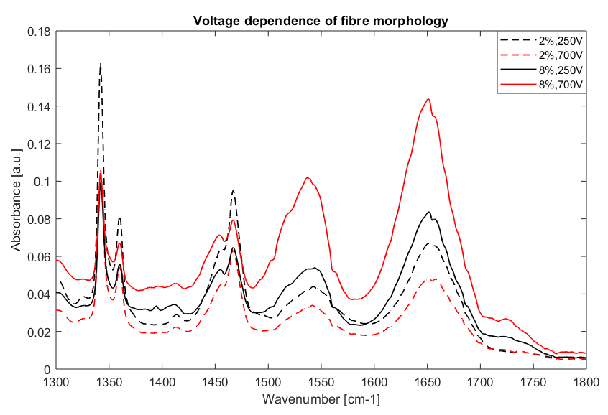
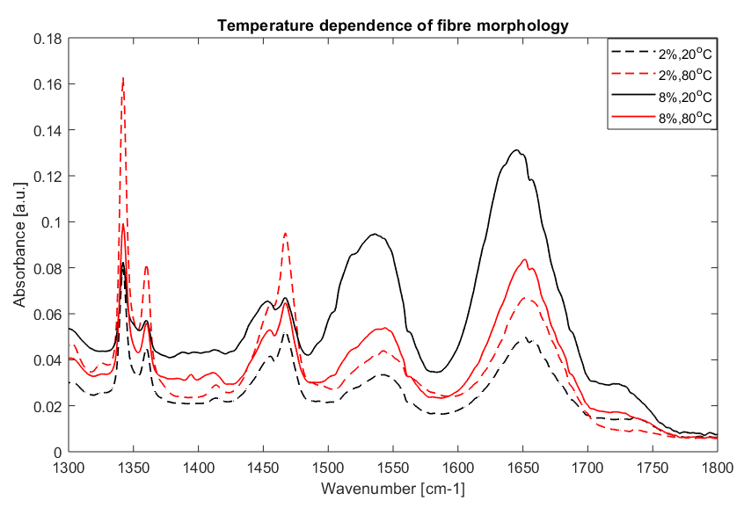
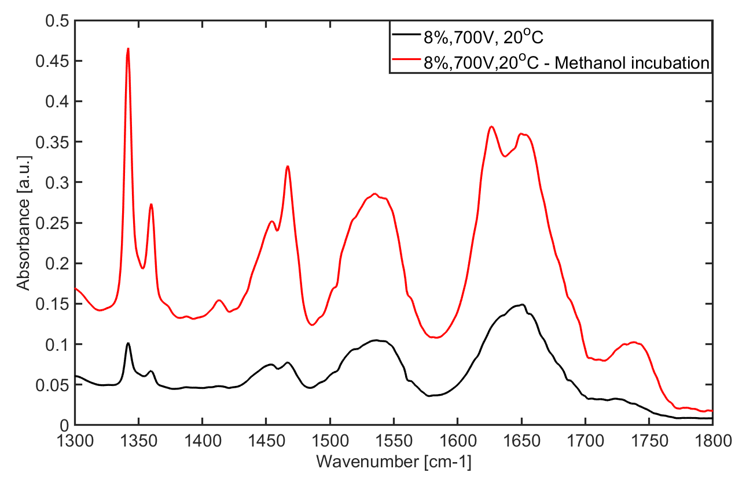
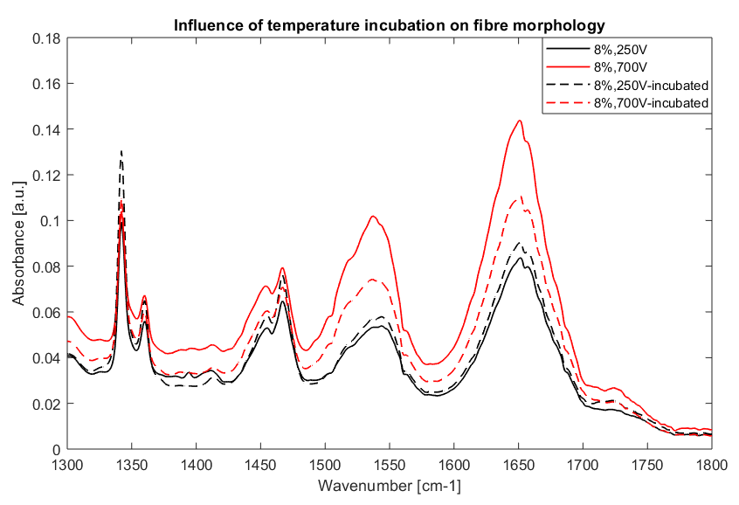
Influences on fibre morphology?

Slide 9
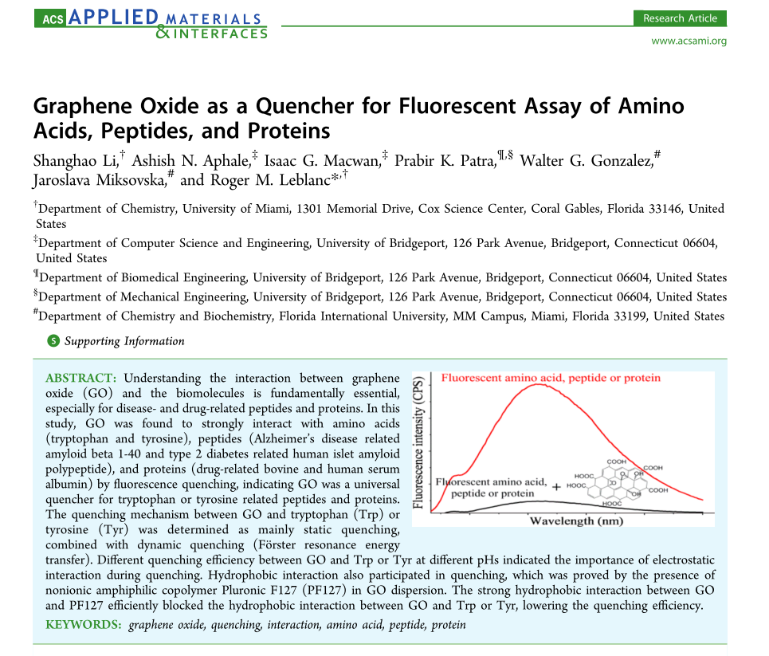
Outlook
Further fibre characterisation
Improve spinning protocols
Fabrication of graphene/protein heterostructures for opto-electronic devices

Slide 10
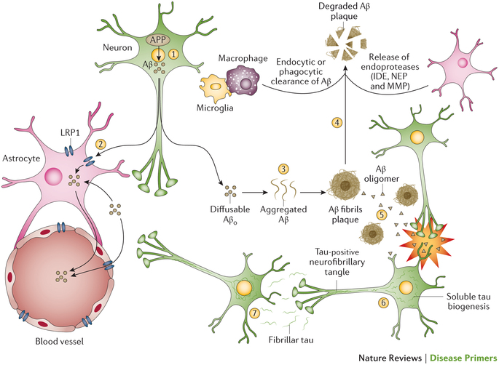
Imaging of pathological amyloids

Slide 11
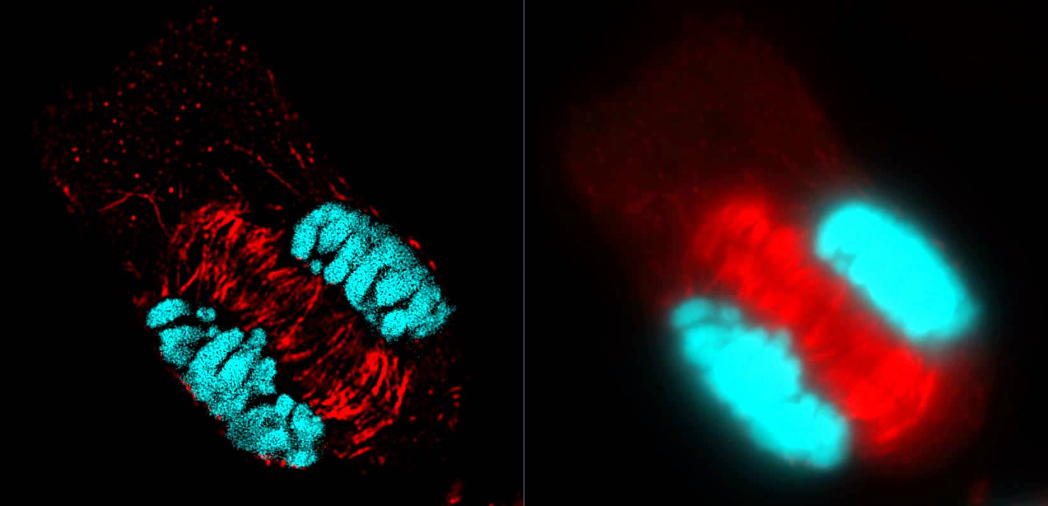
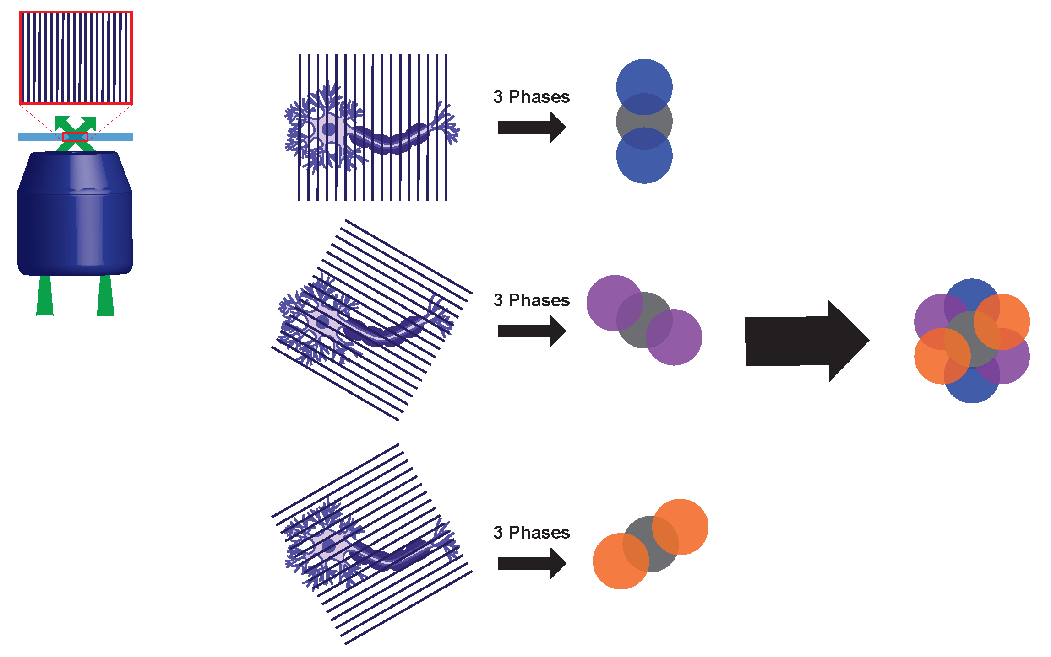
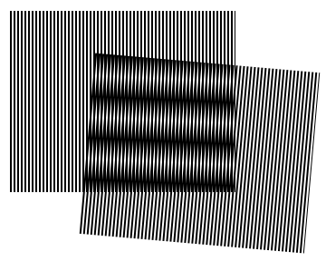
Structured illumination microscopy

Slide 12
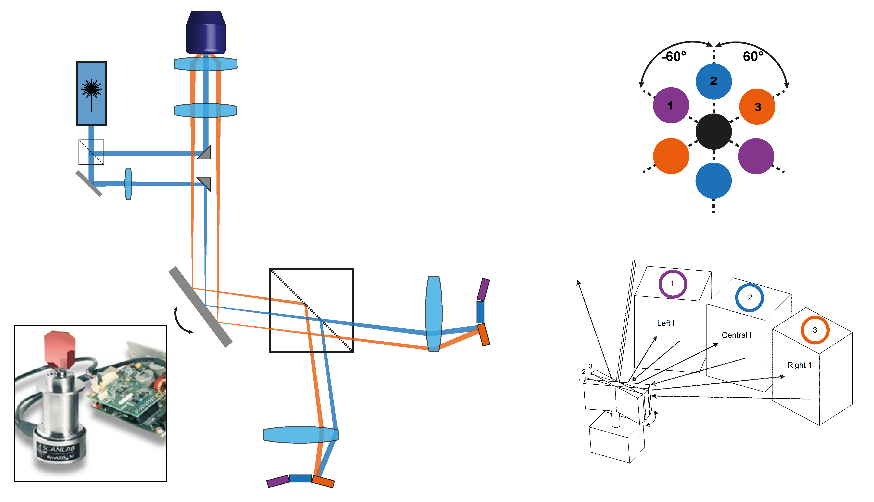
An interferometric SIM design

Slide 13
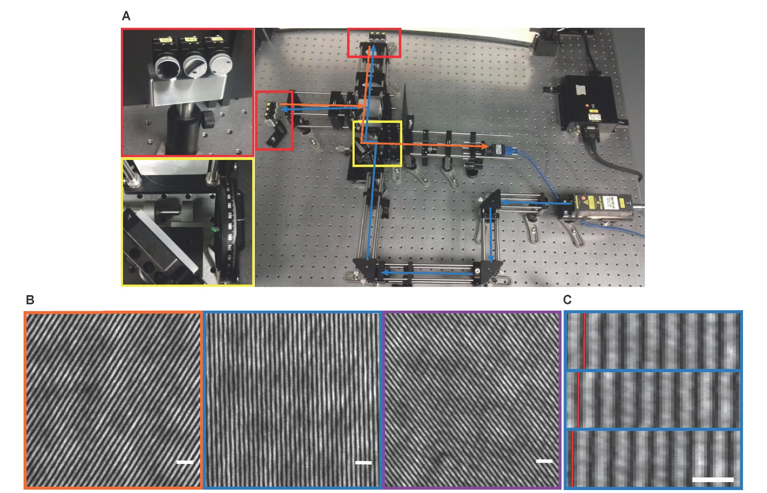

Slide 14
Next steps…
Short term
Long term
Characterise pattern
→Need for telecentric scan lens?
Galvo mirror installation & characterisation
→ How fast can we go?
Installing excitation path into STORM/SIM system in Addenbrooke’s
Imaging projects with different collaborators such as:
Transport of Tau aggregates in synapses
Aggregation mechanism of Huntingtin protein
Influence of antibiotics on nanopore function
Adding 3rd beam for 3D imaging

Slide 15






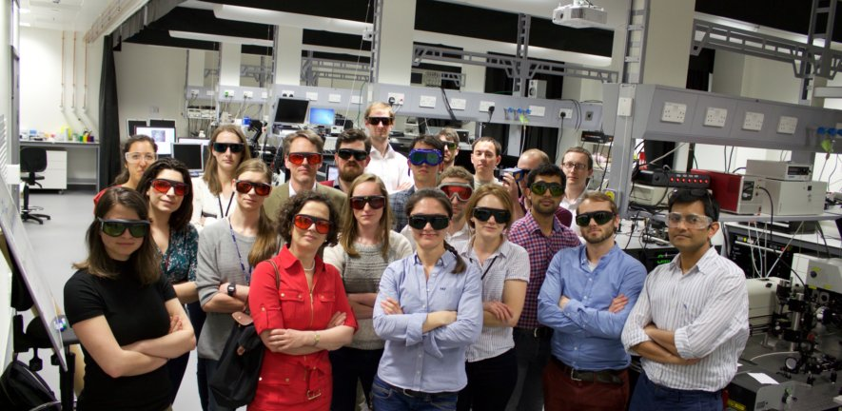
Thank you!

