Slide 1




3D Carbon Nanotubes for Infrared Sensing
Sammy Mahdi, Nanomanufacturing Group
04/10/2018
Sensors Cafe
Notes:
Hi everyone, I’m Sammy and my phd is about developing infrared sensors using carbon nanotubes, one of the most common applications of infrared sensing is thermal.

Slide 2
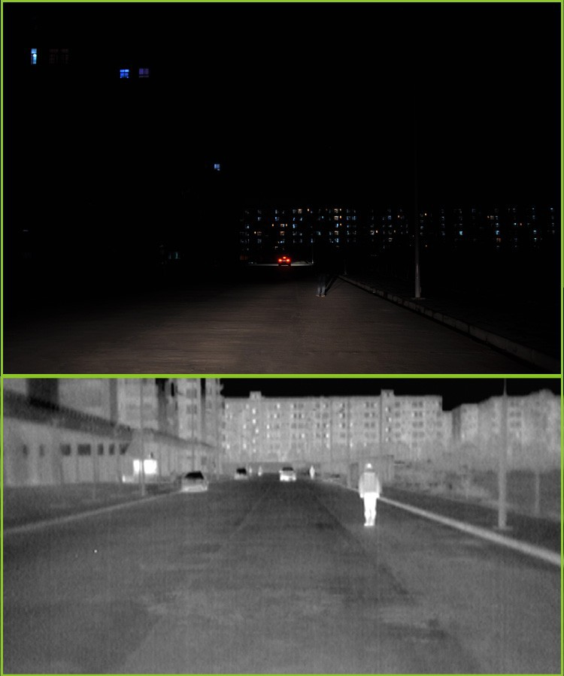
Infrared Sensors
Notes:
Imagine you are an autonomous vehicle and this is what you see during the night, obviously there is not much information there, however if you look at the infrared spectrum, there is so much more.

Slide 3
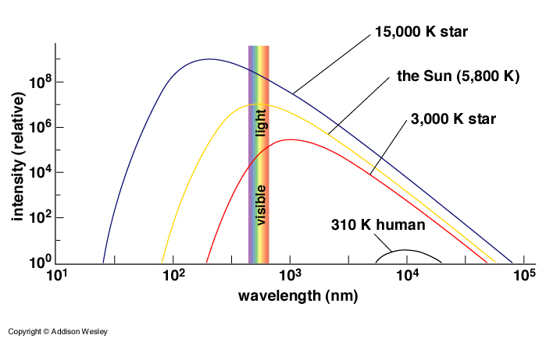
Black Body Radiation
Notes:
So why is there more information in the second photo, it turns out that every object that has a temperature above 0 K, emits energy in the infrared band, so the second image is created by measuring the temperature of the object ahead which is invariant of lighting conditions.

Slide 4
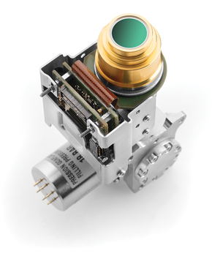
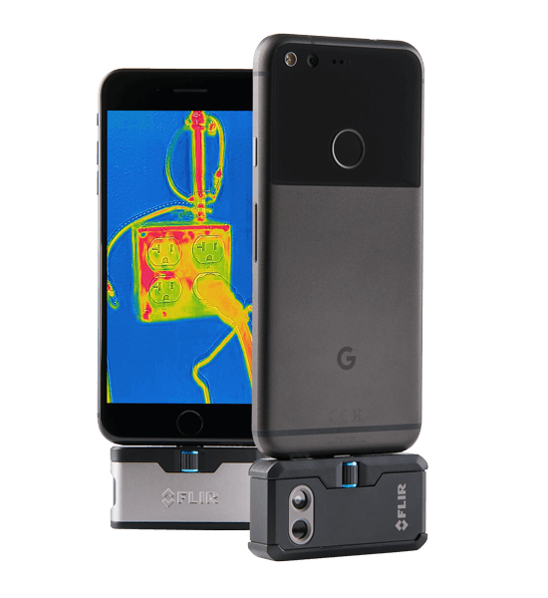
IR Detectors Types
Cooled IR sensors
+ High sensitivity
+ Excellent resolution
High power consumption
Expensive/bulky
Uncooled IR sensors
+ Low power consumption
+ Cheap/portable
Less sensitive
Low response time

Slide 5


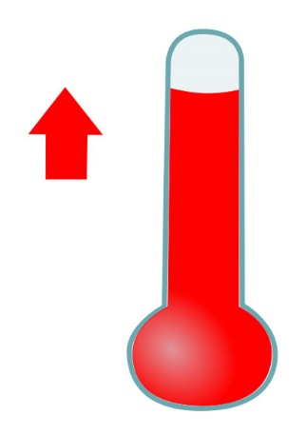
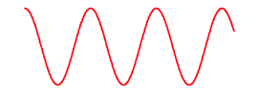


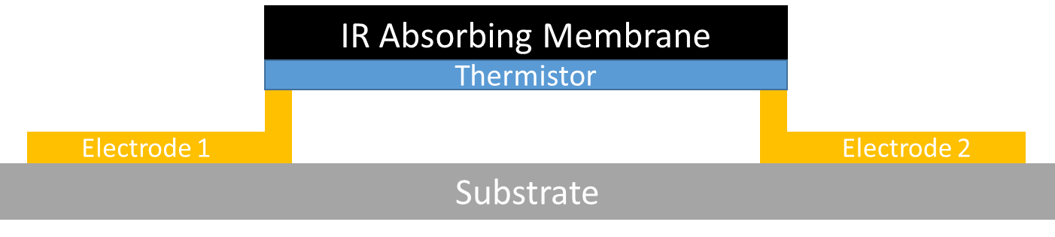

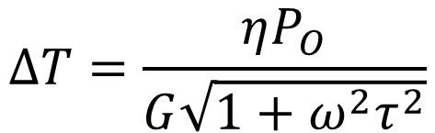
IR Microbolometer
IR Wave
Change in T
Measure T
$$ΔT=\frac{ηP_{O}}{G\sqrt{1+ω^{2}τ^{2}}}$$
$$V_{s}=I_{b} α \text{R} ΔT$$
T
Notes:
Infrared radiation is also know as thermal radiation, if we have an object that absorbs the infrared radiation, then it’s temperature would increase. If our object also changes its electrical properties with the increase of temperature, then we can relate the temperature change to the infrared radiation. One way to construct such device is shown on the figure, you have an IR absorbing membrane and a thermistor which are attached through very thin legs to two electrodes, the reason why the membrane is suspended is so that the temperature change stays in the membrane and is not dissipated to the substrate. In the case of my devices, the CNTs would both function as an IR absorbing membrane and a thermistor.

Slide 6
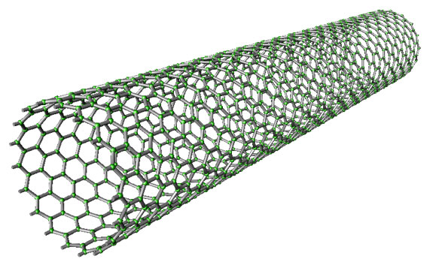
Carbon Nanotubes
Advantages
+ Excellent IR absorption
+ Excellent thermal conductivity
+ Low thermal mass
+ Excellent electrical properties
+ Mechanically robust
+ Complex 3D structures
+ Different functionalization
Notes:
As Kate mentioned previously, CNTs are amazing materials that can be used in variety of applications, the properties in which I am interested is basically all of them.

Slide 7
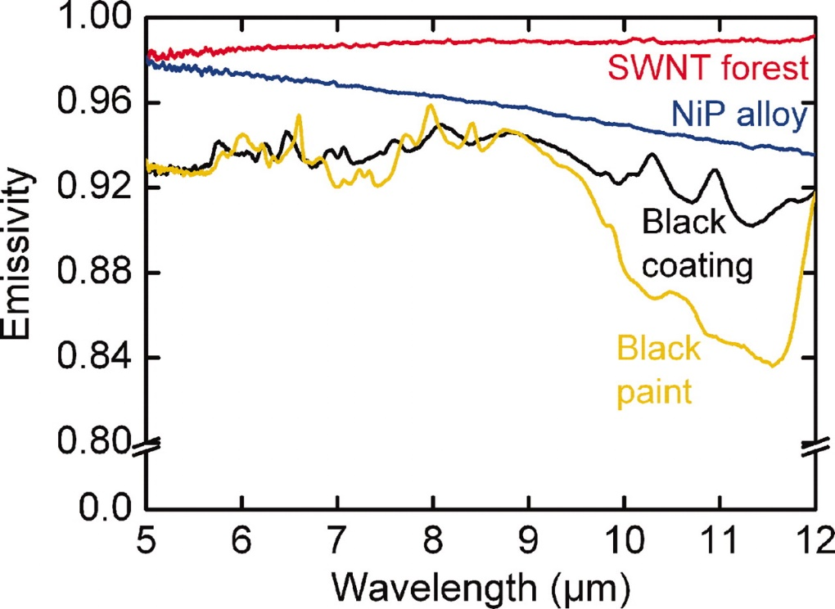
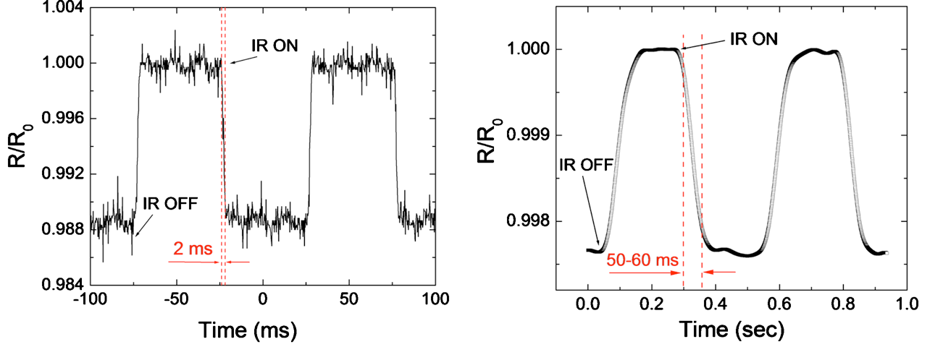
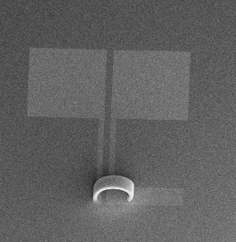
CNT as IR sensors
Excellent IR absorption
Low thermal
mass
Bolometer
3D structures
Notes:
The reason why CNTs can make good IR sensors is the following, they have excellent IR absorption. In addition, they have low thermal mass which means that the response time of my sensors can be very low and finally we can structure them in 3D shapes thus maximising the absorption area.

Slide 8
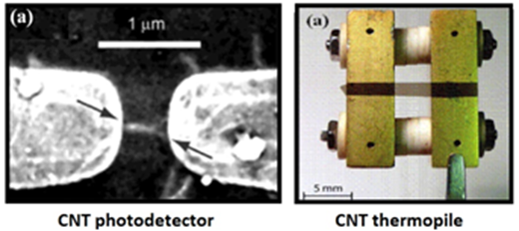
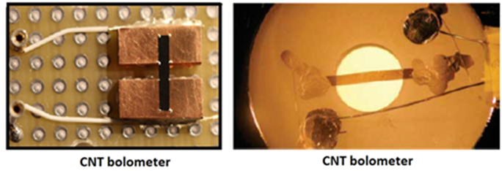
Current progress on CNT IR sensors
Notes:
There is some progress on CNT infrared sensor but most work has been done as a proof of concept and is not easily scalable. You can see some of the crude devices here.

Slide 9
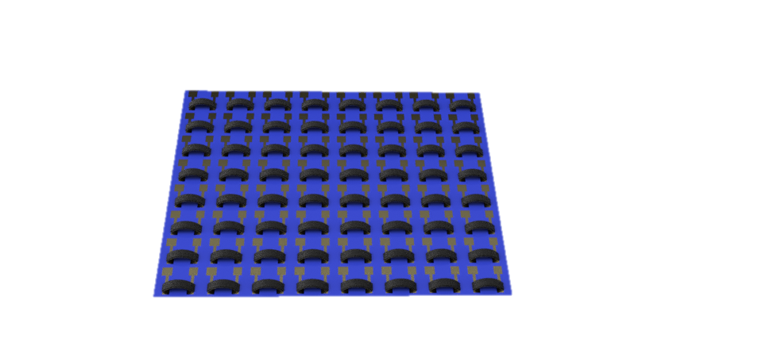
Desired final device
Notes:
We envision the final device to look something like where we have an array of individual sensors

Slide 10
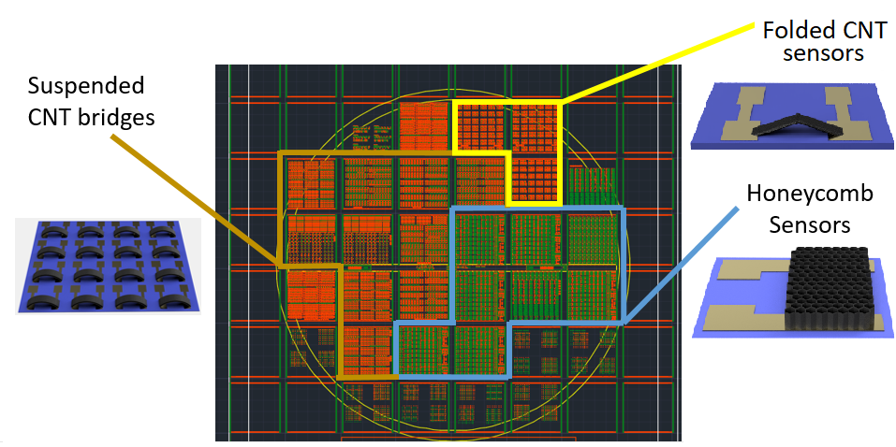
Photolithography Mask
Notes:
In order to fabricate the devices, we have to use lithography techniques, I won’t go into detail on how photolithography works but the first I had to do was to design a mask. The mask is essentially the blueprint for my devices, after I have the blueprint I would expose the patterns on silicon wafer and grow the carbon nanotubes.

Slide 11
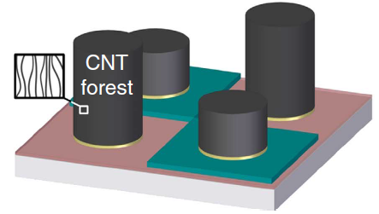
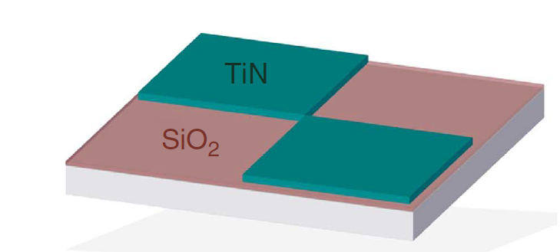
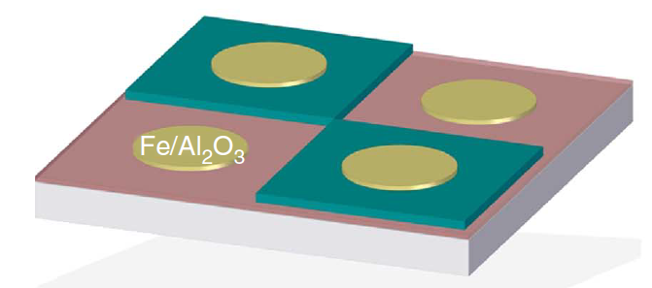
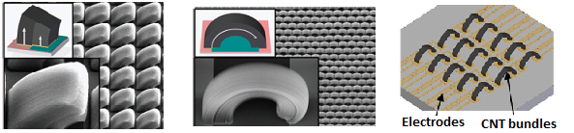
Suspended CNT bridges
Pattern electrodes
Pattern catalyst
CVD growth
Notes:
So how do you grow nanotubes? It’s very similar to growing a plan, first you need a soil, in our case we have two different soils – red one and green one, after that we need to put the seeds which is the catalyst (yellow in our schematic), after that we keep them warm at around 800 degrees and we feed them various gasses and from the catalysts we start seeing forests of carbon nanotubes. Something very interesting happens if you plant seeds on two different soils

Slide 12
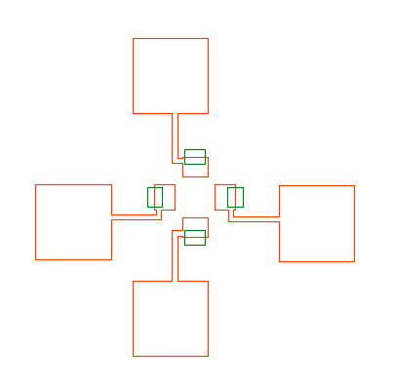
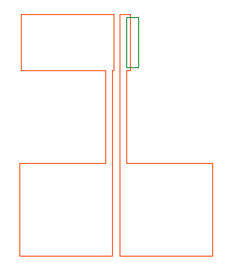
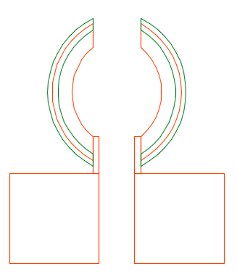

Suspended CNT bridges
Two-sided bridge
One-sided bridge
“Flowers”
“Crabs”
Feature | Overlap | Film widths | W/L ratios
Two-sided-bridge | 20 – 80% | 3 μm, 5μm, 7μm 10 μm, 20 μm | 1, 2, 4
One-sided bridge | 20 – 80% | 3 μm, 5μm, 7μm 10 μm, 20 μm | 1, 2, 4

Slide 13
Double-sided bridges

Slide 14
Double sided bridges

Slide 15
Single sided bridges

Slide 16
Single sided bridges

Slide 17
Single sided bridges

Slide 18
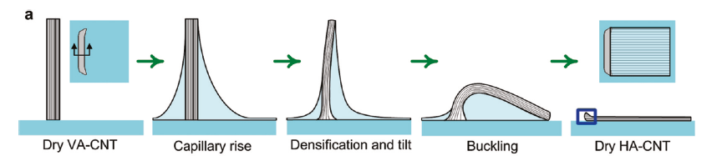


Flopped CNT bridges
One-sided flop
Two-sided flop

Slide 19
Flopped structures

Slide 20
Flopped structures

Slide 21
Flopped structures

Slide 22
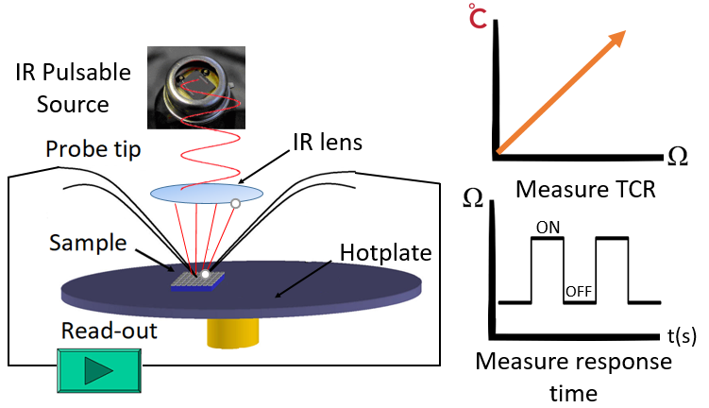
Test setup

Slide 23
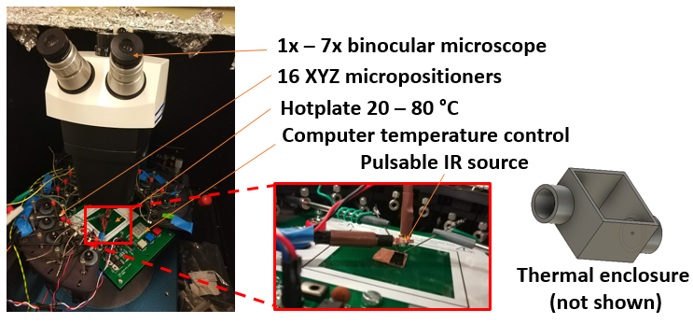
Test setup

Slide 24
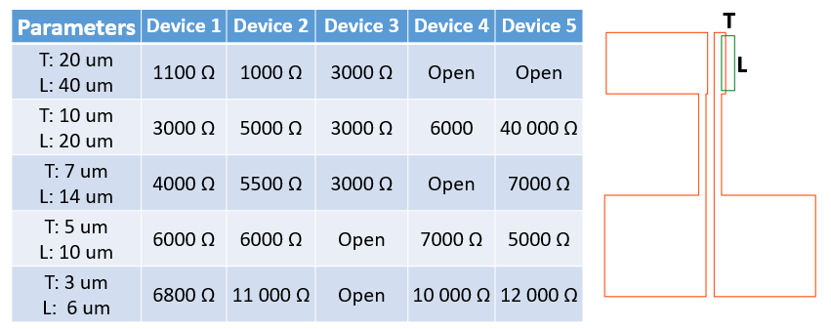
Electrical characterization

Slide 25
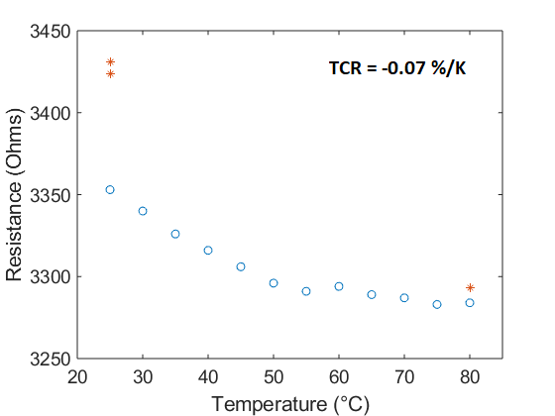
Single Sided | T: 10 um L: 20 um

Slide 26
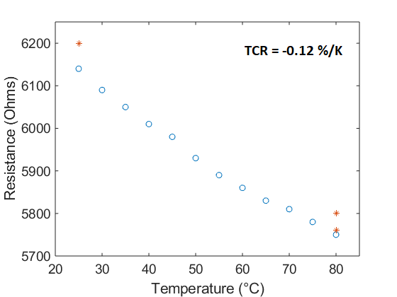
Single Sided | W: 5 um L: 10 um

Slide 27
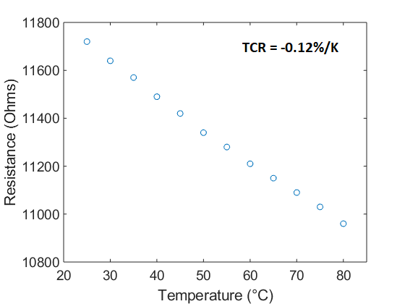
Single Sided | W: 3 um L: 6 um

Slide 28
Annealing test

Slide 29
Annealing experiment

Slide 30
IR response
OFF
OFF
OFF
OFF
ON
ON
ON
OFF
ON

Slide 31
IR Response | Fourier transform

Slide 32
Future steps
Improve IR characterization setup
Focusing lens/high power source
Test double sided bridges
Get better idea about TCR variations across samples
Improve TCR
Vary growth temperature (different quality CNTs)
Functionalize with polymers/metal oxides
Reduce 1/f noise
Design new mask with 8x8 arrays

Slide 33
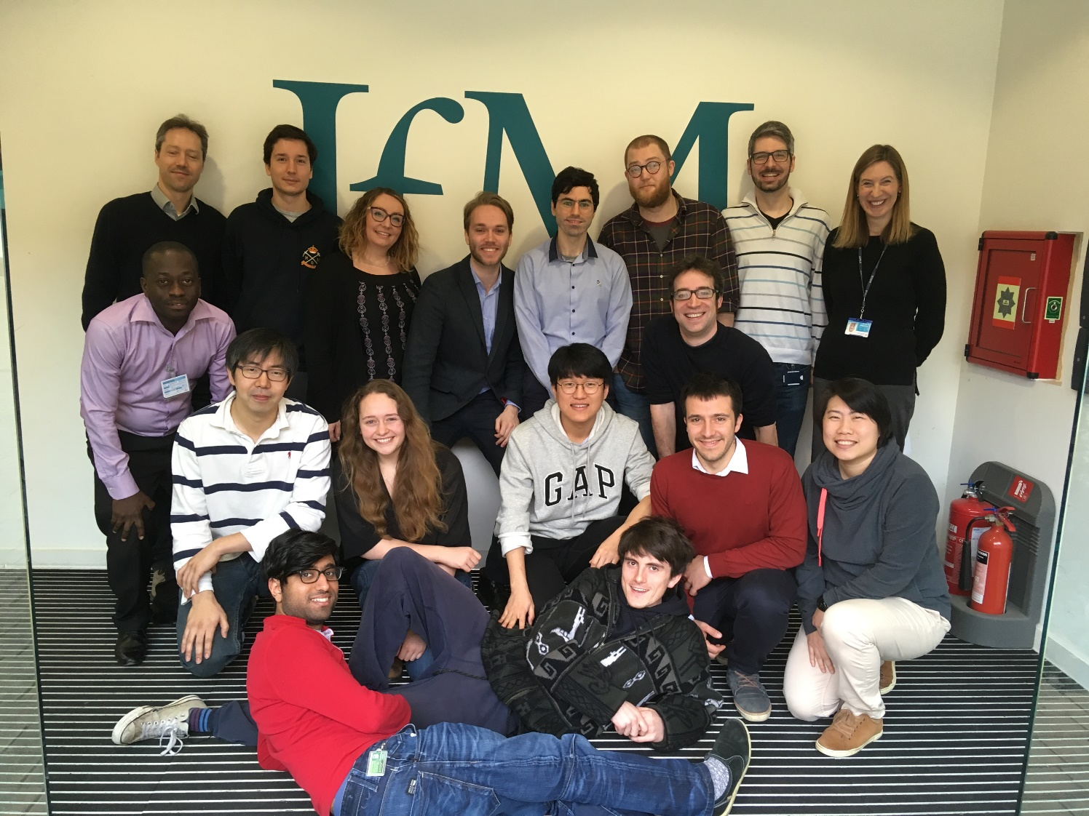
Acknowledgements
NanoManufacturing Group

Slide 34
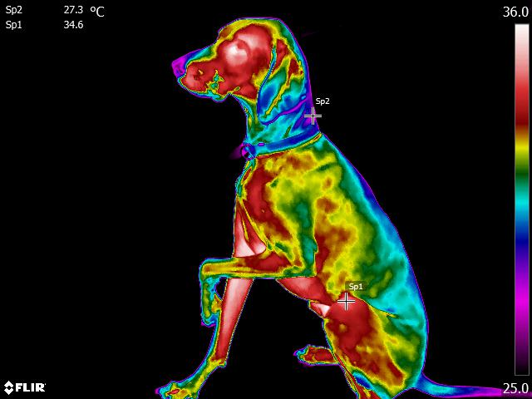
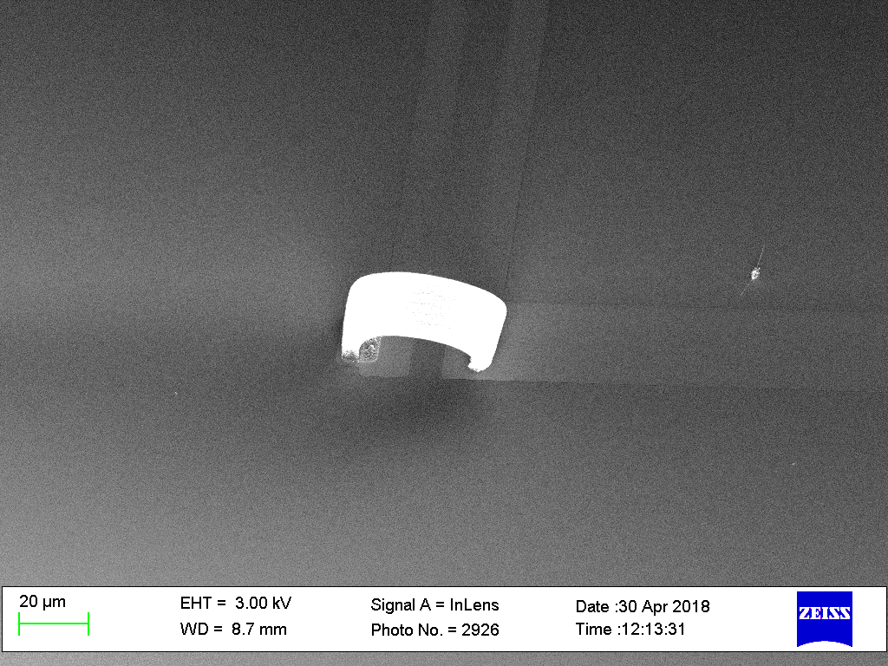
Summary
Device Concept
Fabrication process
Successful device
Array of devices
Thermal Camera

Slide 35


Slide 36

Unique features generator
Sweeps film
thickness
Sweeps catalyst/electrode overlap %

Slide 37
Future work
Finish mask and send for fabrication
Build IR test setup
Get training on lithography
Optimize lithography
Optimize growth
Test devices
Mask v2.0

Slide 38
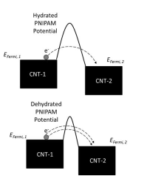

Proposed device #2
$$V_{s}=I_{b} α \text{R} ΔT$$
Honeycombs between electrodes
Functionalize with
polymers
Improved
TCR

Slide 39
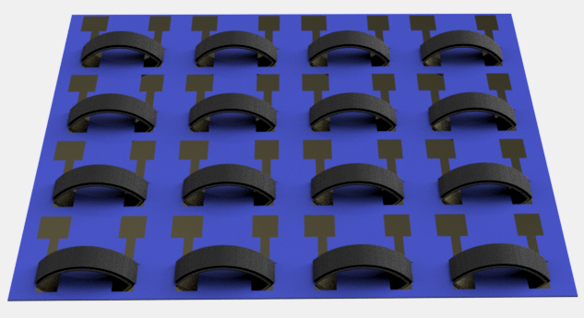
Proposed method #1
Notes:
Talk about the advantages of the bridges

Slide 40

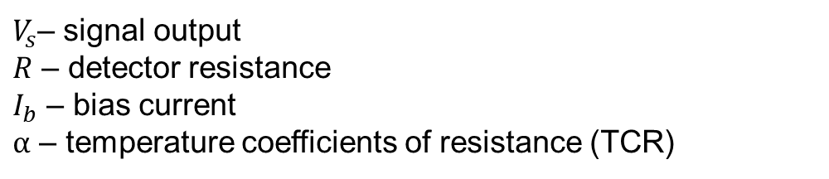
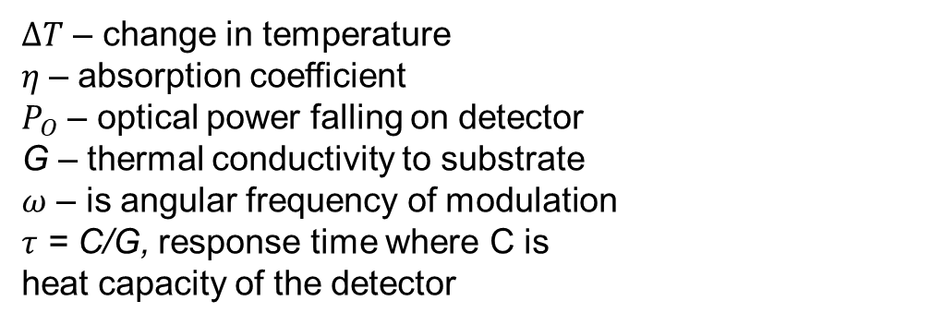

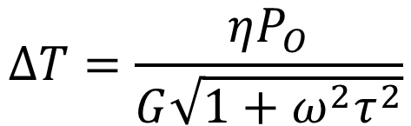
IR Uncooled Microbolometer
$$ΔT=\frac{ηP_{O}}{G\sqrt{1+ω^{2}τ^{2}}}$$
$$V_{s}=I_{b} α \text{R} ΔT$$
$ΔT$ – change in temperature
𝜂 – absorption coefficient
$P_{O}$ – optical power falling on detector
G – thermal conductivity to substrate
$ω$ – is angular frequency of modulation
$τ$ = C/G, response time where C is
heat capacity of the detector
$V_{s}$– signal output
$R$ – detector resistance
$I_{b}$ – bias current
$α$ – temperature coefficients of resistance (TCR)

Slide 41
IR Detectors Types
Cooled IR sensors
+ High sensitivity
+ Excellent resolution
High power consumption
Expensive/bulky
Uncooled IR sensors
+ Low power consumption
+ Cheap/portable
Less sensitive
Low response time
Notes:
Two different types, initially cooled IR sensors,

Slide 42
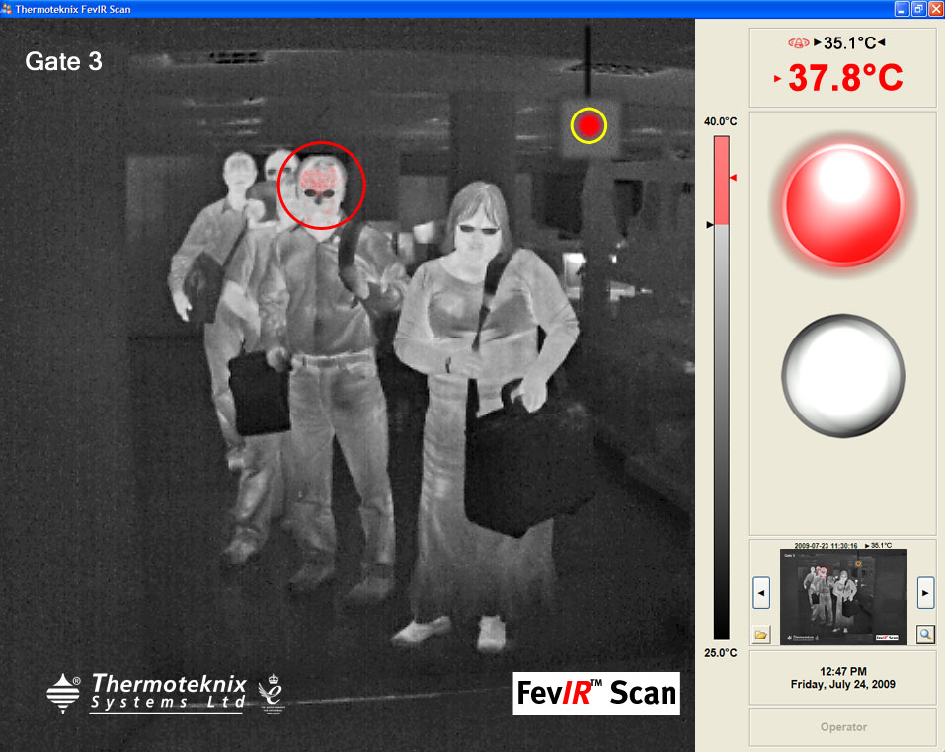
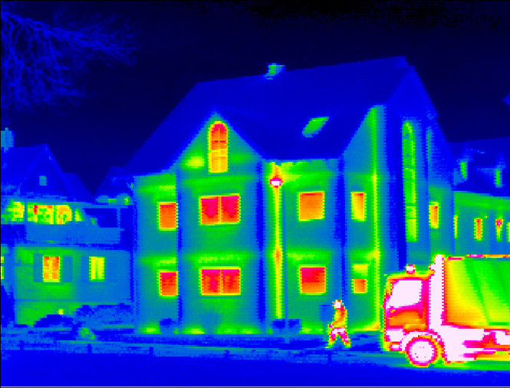
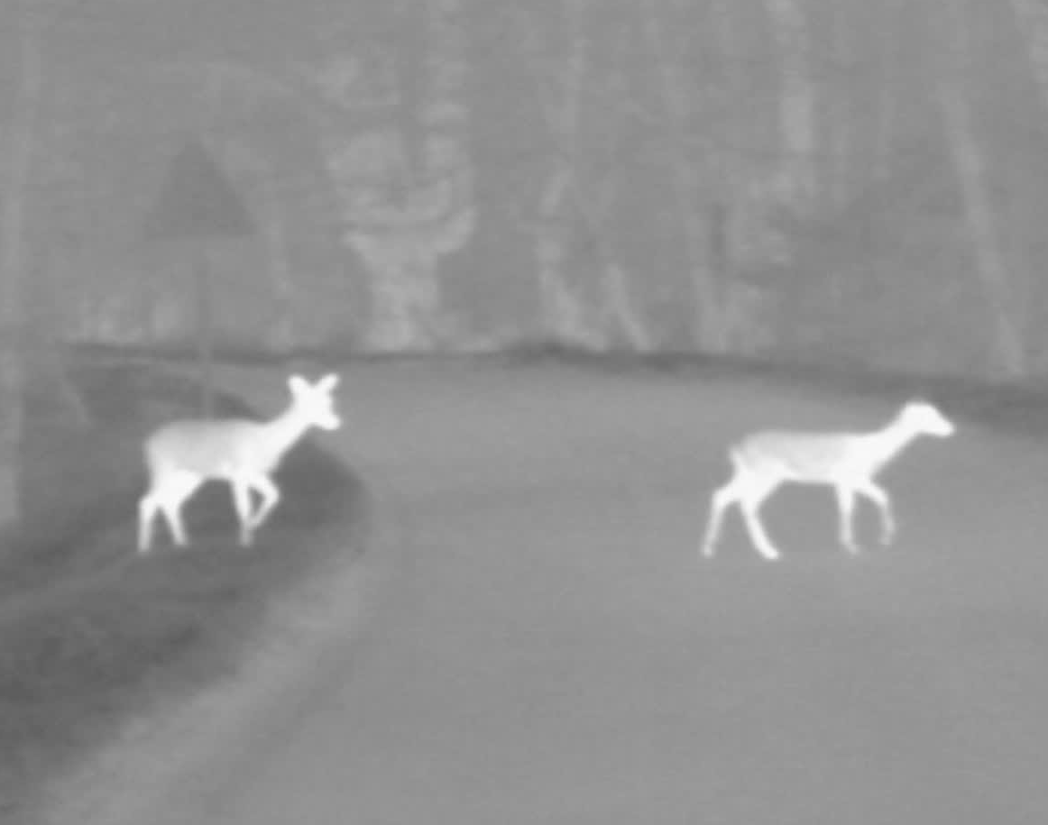
Thermal Imaging
Fever screening at airports
Measuring
building efficiency
Harsh conditions/night imaging
Notes:
Applications …

Slide 43
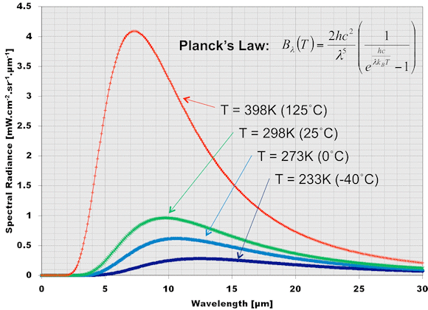
Black Body Radiation
Notes:
Every object above 0 K emits EM, the intensity of the radiation is a function of the temperature of the object and the wavelength of the radiation

